Slide 1

Getting started…
Please sit in rows A through J only
Form groups of 3-5 students
Discuss: what are you most confused about?
Post questions on Ask For Me!

Slide 2

Notes:
How satisfied were you with your grade on Quiz #4?
https://www.polleverywhere.com/multiple_choice_polls/caAznZGBOGgatNxyQf7i8

Slide 3
Sampling Distributions to Confidence Intervals (continued)
Psych 100A Spring 2019
Prof. Jim Stigler

Slide 4
Analyzing ScienceData
A practical application of sampling distributions

Slide 5
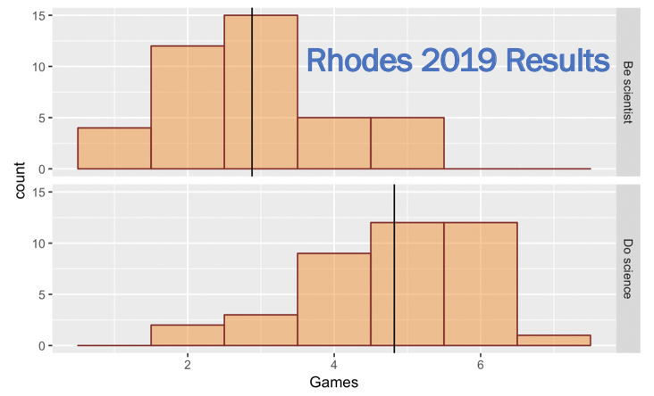
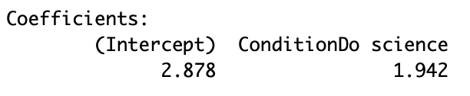
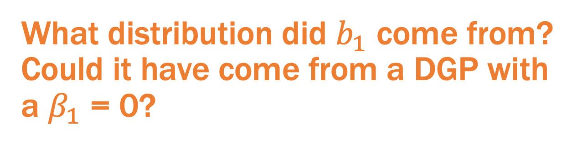
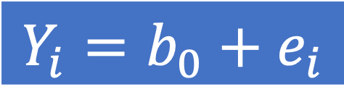

$$Y_{i}=b_{0}+b_{1}X_{i}+e_{i}$$
$$Y_{i}=b_{0}+e_{i}$$
What distribution did $b_{1}$ come from? Could it have come from a DGP with a $β_{1}$ = 0?

Slide 6
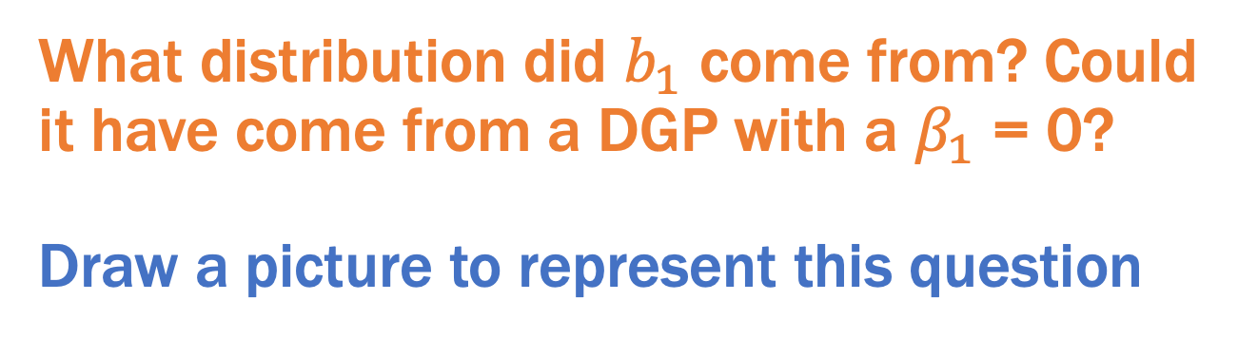
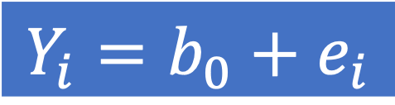
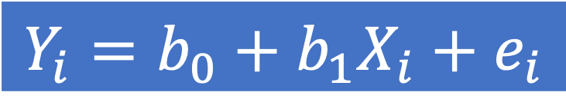
$$Y_{i}=b_{0}+b_{1}X_{i}+e_{i}$$
$$Y_{i}=b_{0}+e_{i}$$
What distribution did $b_{1}$ come from? Could it have come from a DGP with a $β_{1}$ = 0?
Draw a picture to represent this question

Slide 7
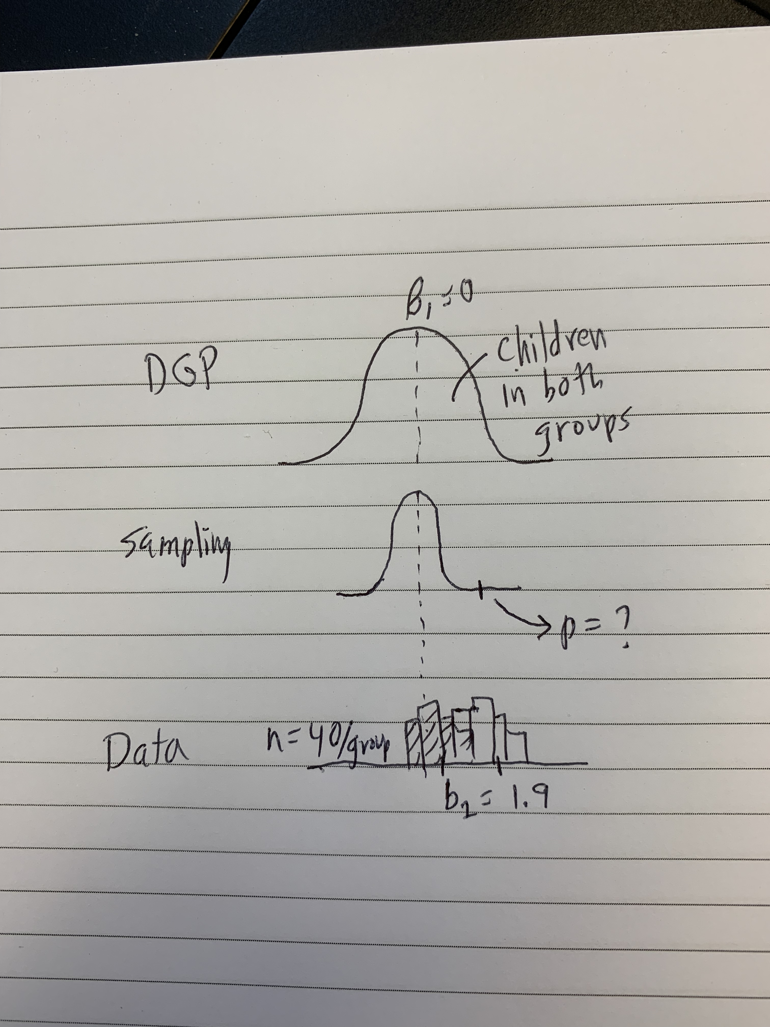
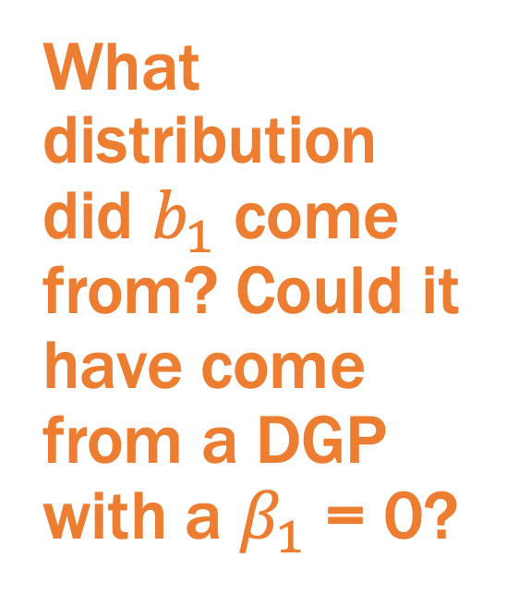
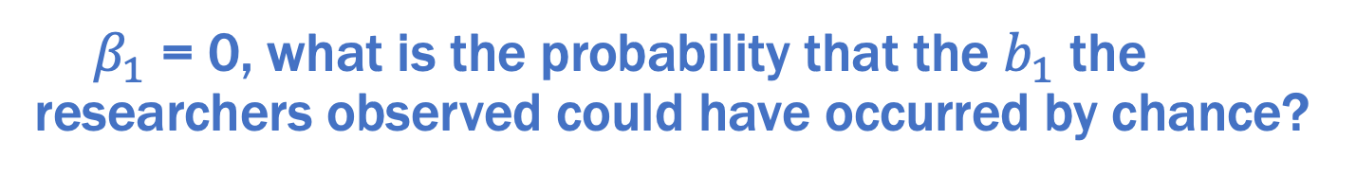
My Picture 1.0 with Sampling Distribution
What distribution did $b_{1}$ come from? Could it have come from a DGP with a $β_{1}$ = 0?
If ${ β}_{1}$ = 0, what is the probability that the $b_{1}$ the researchers observed could have occurred by chance?

Slide 8
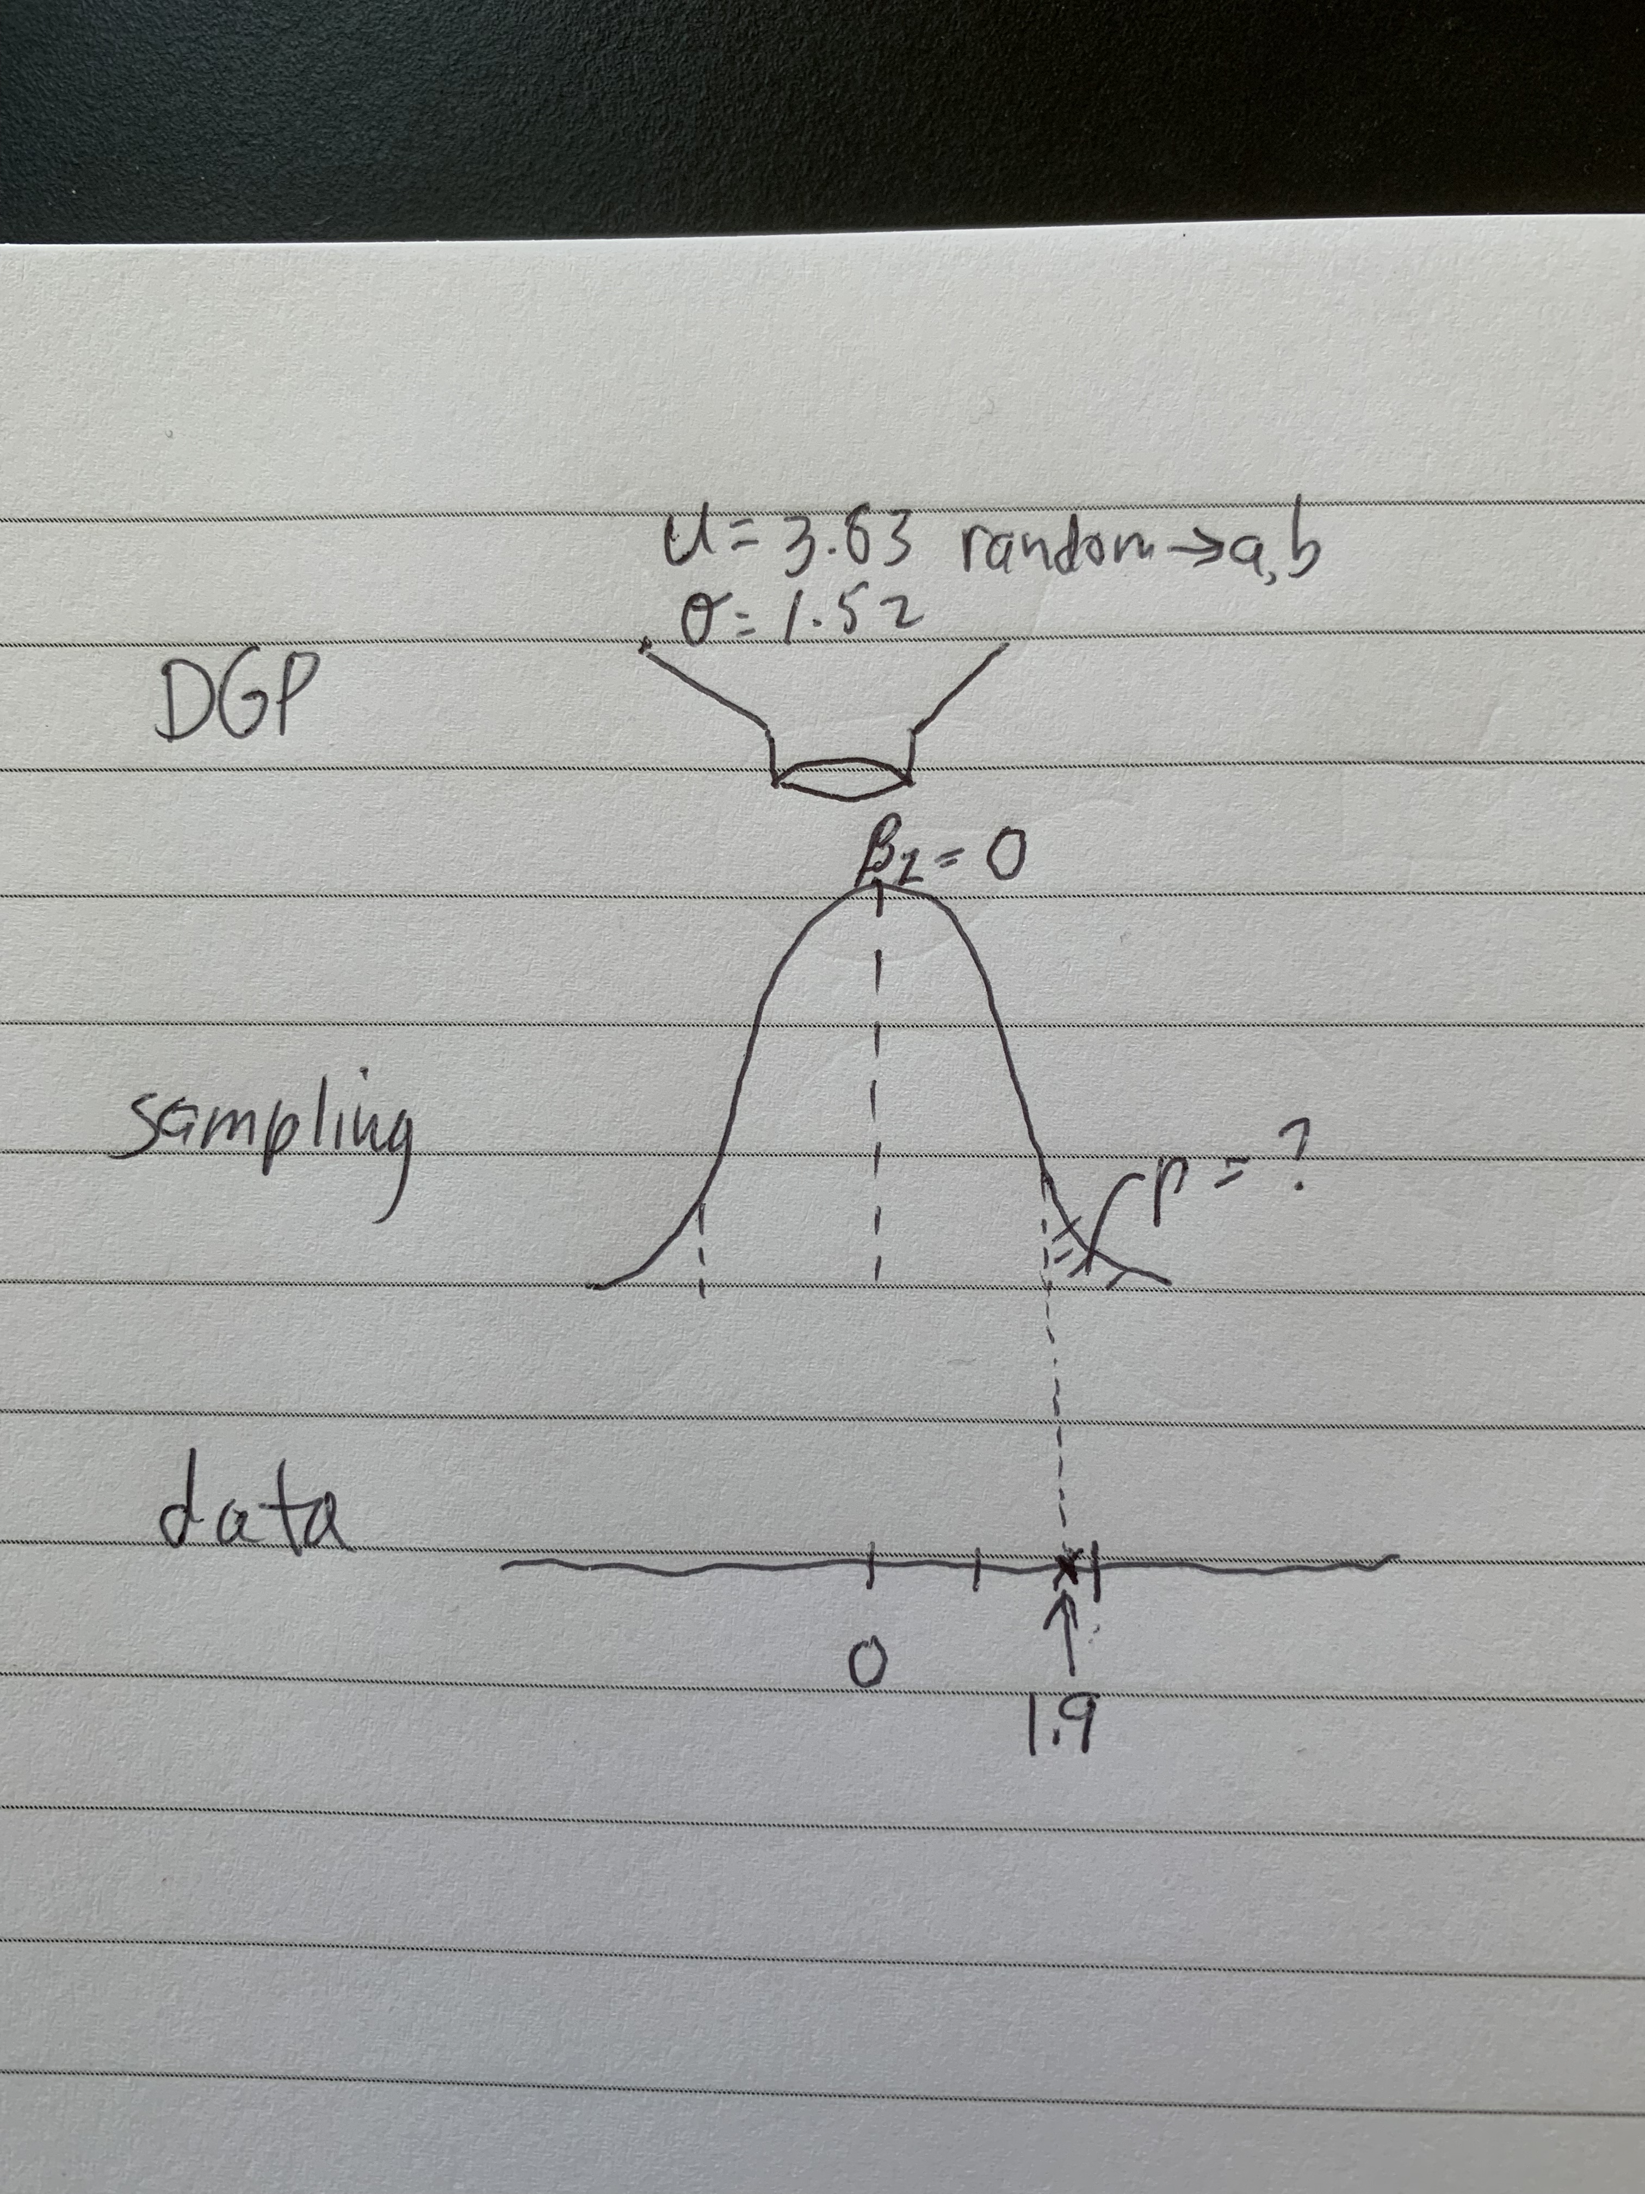
My Picture 2.0 with Sampling Distribution
What distribution did $b_{1}$ come from? Could it have come from a DGP with a $β_{1}$ = 0?
If ${ β}_{1}$ = 0, what is the probability that the $b_{1}$ the researchers observed could have occurred by chance?

Slide 9
Four ways of creating sampling distributions
Simulation
Randomization
Bootstrapping
Mathematical models
Let’s use simulation to answer this question.

Slide 10
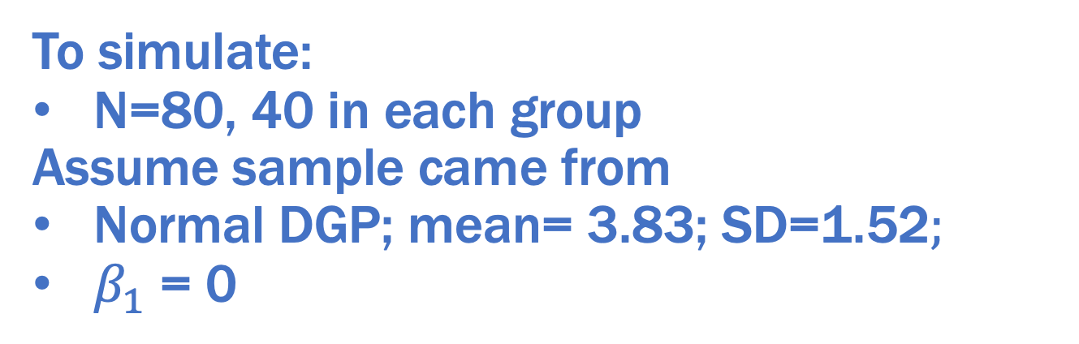
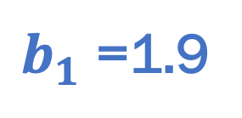
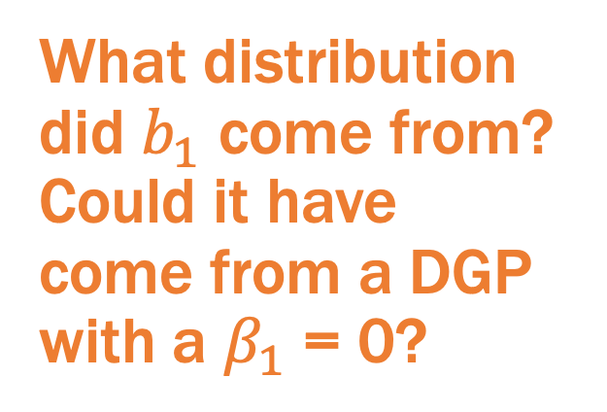
What distribution did $b_{1}$ come from? Could it have come from a DGP with a $β_{1}$ = 0?
$b_{1}$ =1.9
To simulate:
N=80, 40 in each group
Assume sample came from
Normal DGP; mean= 3.83; SD=1.52$;$
$β_{1}$ = 0

Slide 11
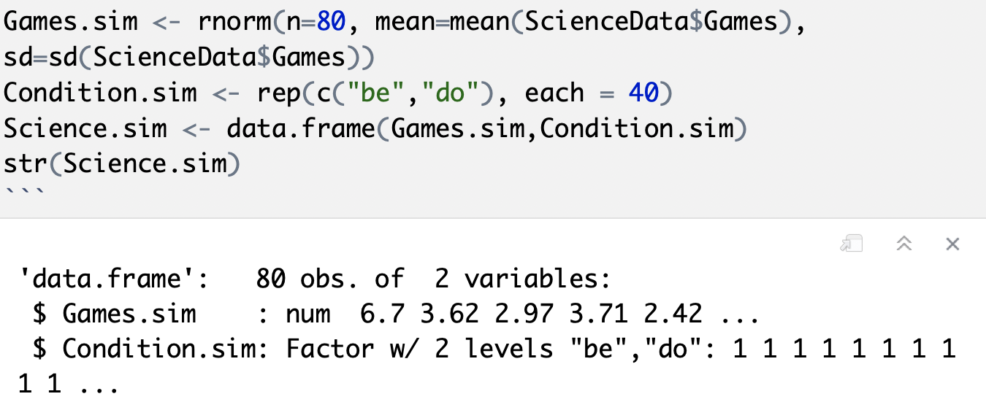
Simulate a single random sample

Slide 12
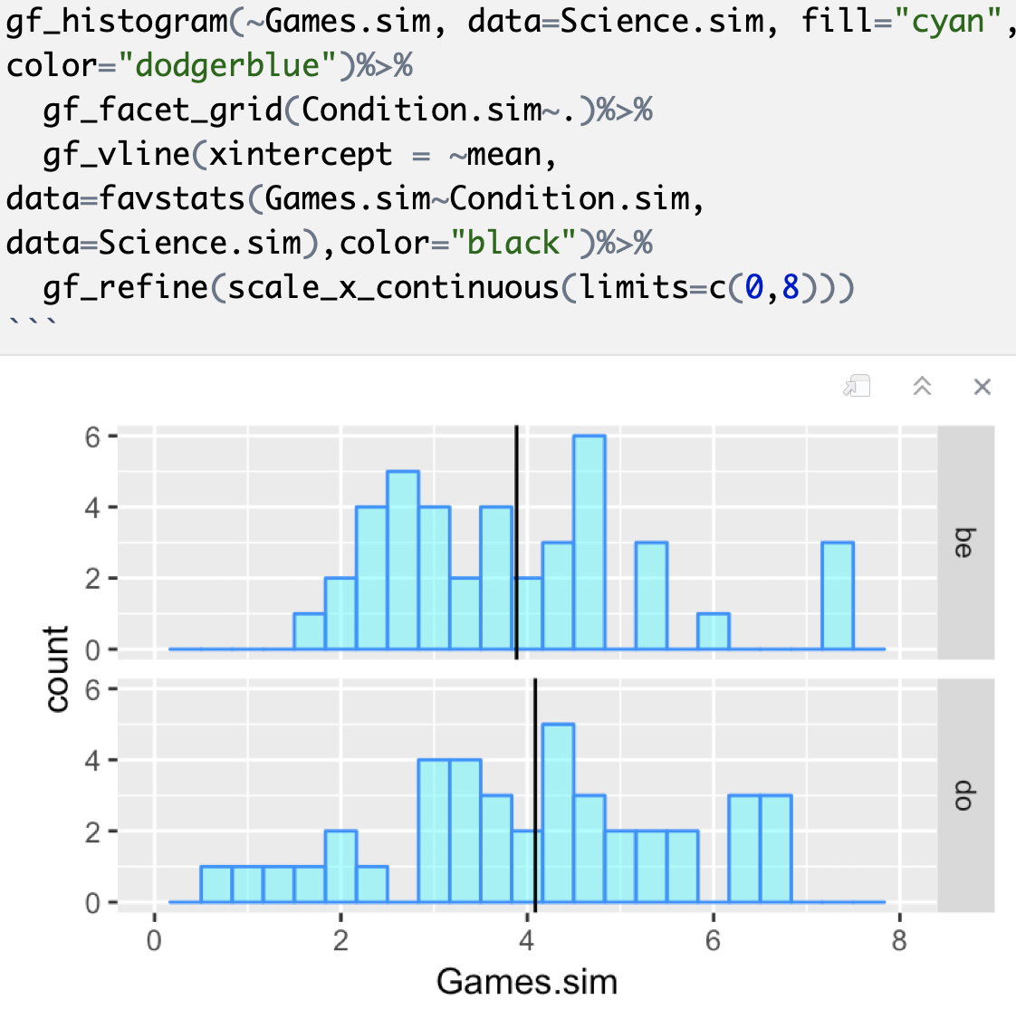
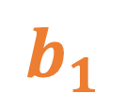
$$b_{1}$$

Slide 13
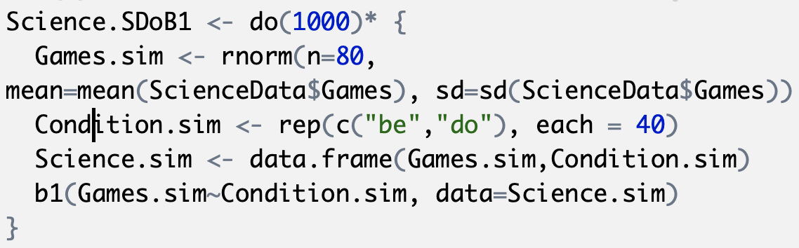
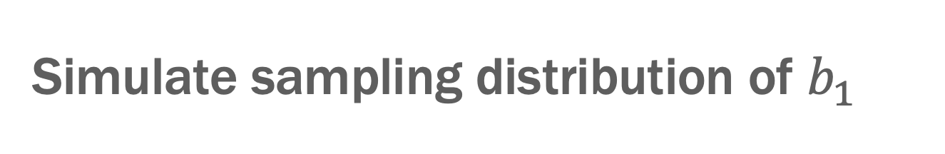
Simulate sampling distribution of $b_{1}$

Slide 14
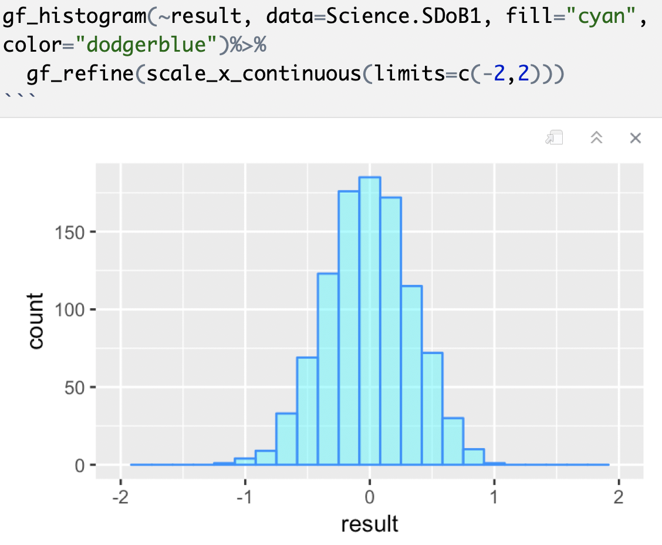
Simulate sampling distribution of $b_{1}$

Slide 15
Why did we make this sampling distribution? What question were we trying to answer?

Slide 16
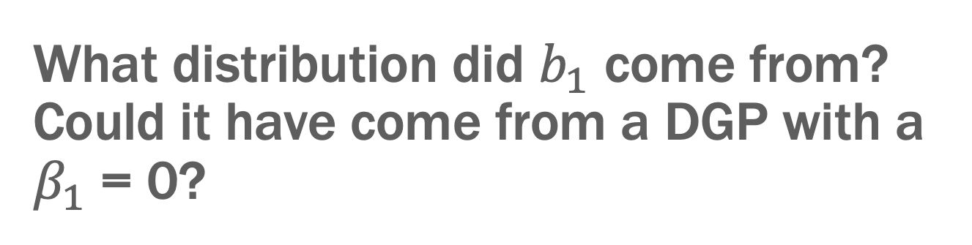


What distribution did $b_{1}$ come from? Could it have come from a DGP with a $β_{1}$ = 0?
$$Y_{i}=b_{0}+b_{1}X_{i}+e_{i}$$
$$Y_{i}=b_{0}+e_{i}$$
p=?

Slide 17
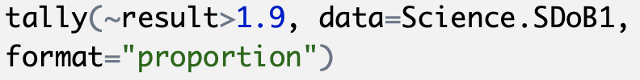
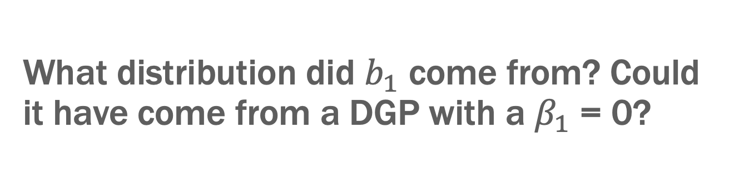

What distribution did $b_{1}$ come from? Could it have come from a DGP with a $β_{1}$ = 0?
$$Y_{i}=b_{0}+b_{1}X_{i}+e_{i}$$
$$Y_{i}=b_{0}+e_{i}$$
p=.000
Discuss: What does this result mean? (Use your picture)

Slide 18
My drawing

Slide 19
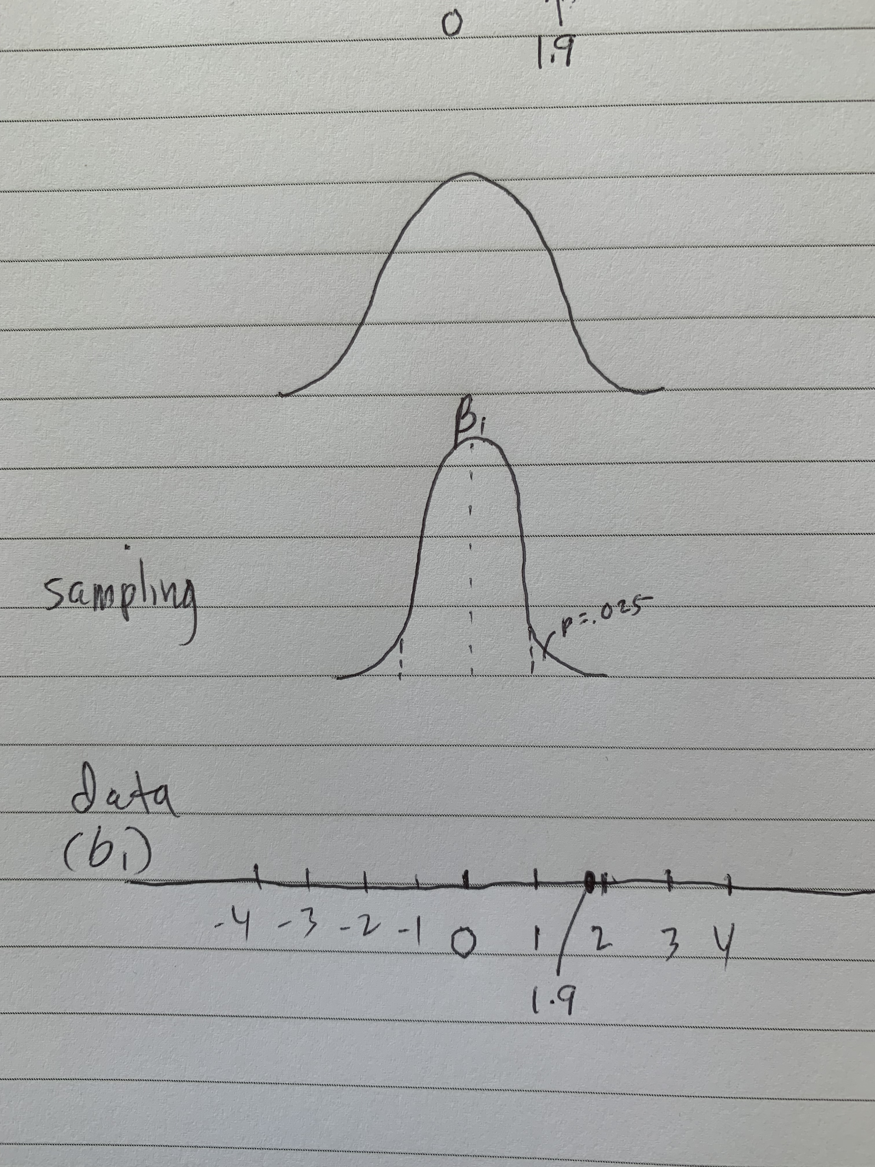
Cut and move: the basis for confidence intervals

Slide 20
Four ways of creating sampling distributions
Simulation
Randomization
Bootstrapping
Mathematical models

Slide 21
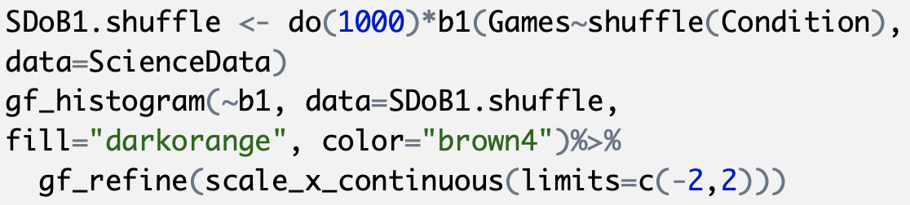
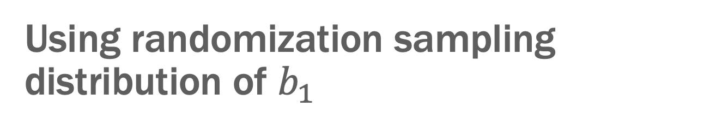
Using randomization sampling distribution of $b_{1}$
Discuss: What will be the shape of this sampling distribution? What will be center? What will be the spread?

Slide 22
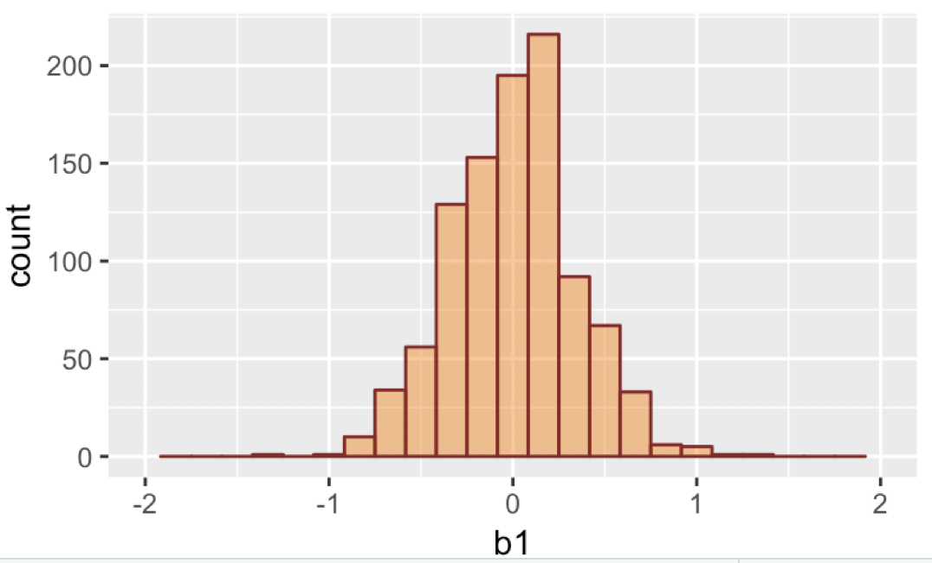
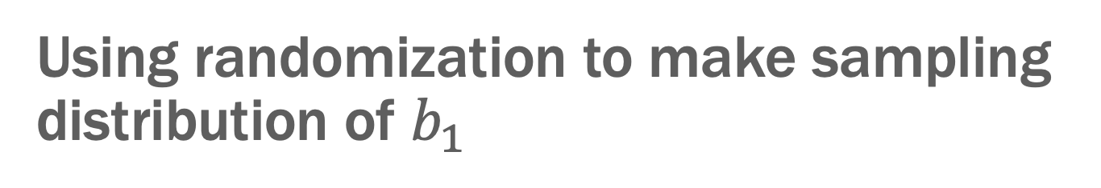
Using randomization to make sampling distribution of $b_{1}$
p=.000

Slide 23
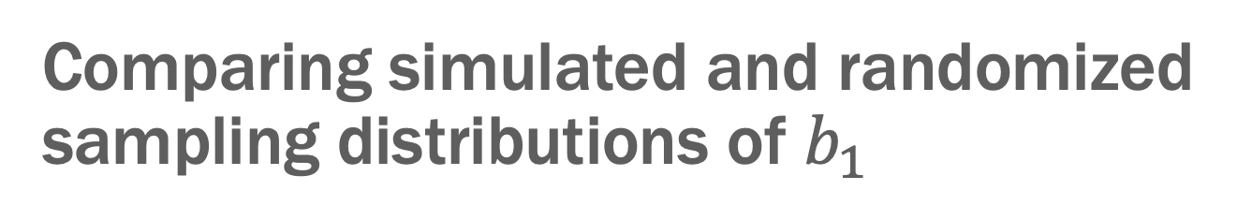
Comparing simulated and randomized sampling distributions of $b_{1}$
Standard Errors
.340 .349

Slide 24
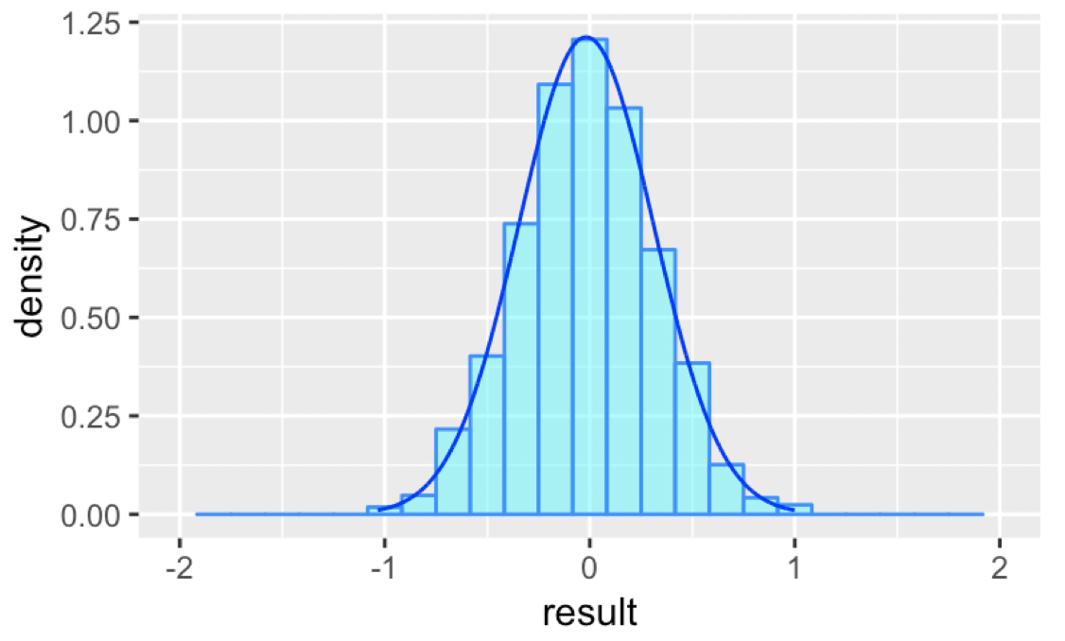
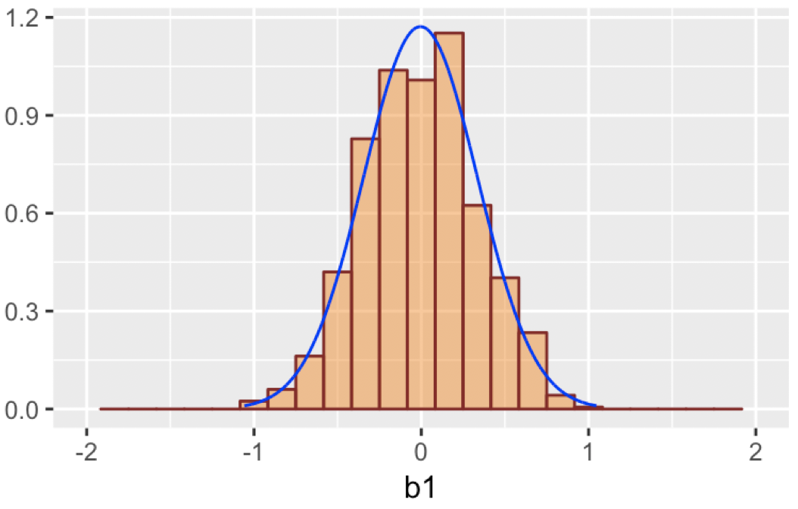

Using the normal curve to model sampling distribution of b1
Simulated Randomized
Why do you think the simulated sampling distribution looks more normal?

Slide 25
Notes:
Why do you think the simulated sampling distribution looks more normal than the randomized sampling distribution?
https://www.polleverywhere.com/discourses/mFAgNupE11Vcw55PH9wzk

Slide 26
Confidence Intervals

Slide 27
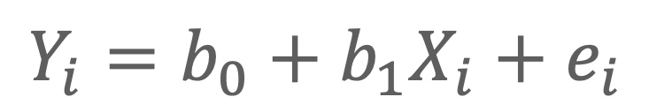
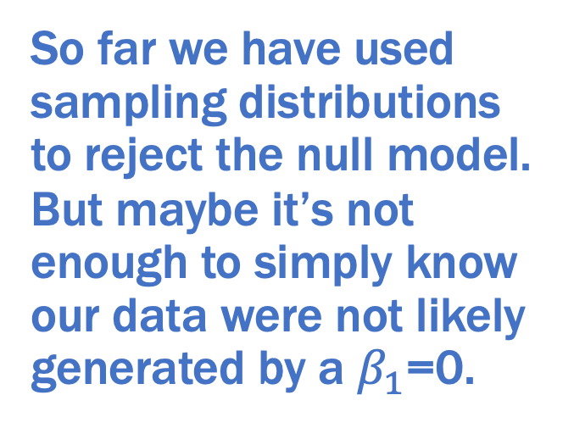
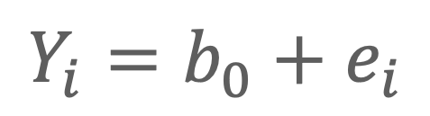
Two-group model:
$$Y_{i}=b_{0}+b_{1}X_{i}+e_{i}$$
Empty model:
$$Y_{i}=b_{0}+e_{i}$$
1.9
So far we have used sampling distributions to reject the null model. But maybe it’s not enough to simply know our data were not likely generated by a $β_{1}$=0.

Slide 28
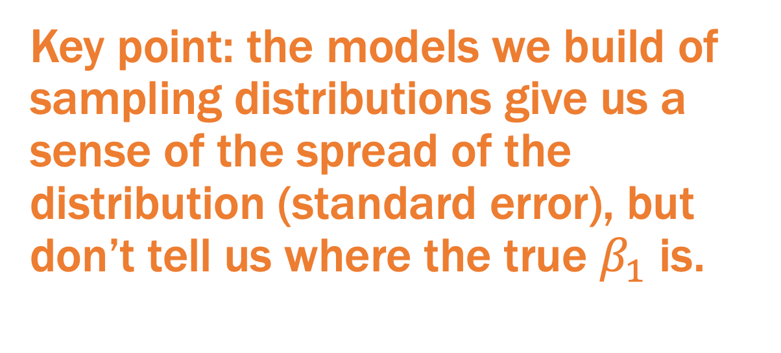
Key point: the models we build of sampling distributions give us a sense of the spread of the distribution (standard error), but don’t tell us where the true $β_{1}$ is.

Slide 29
Cut and slide with a randomized sampling distribution.

Slide 30
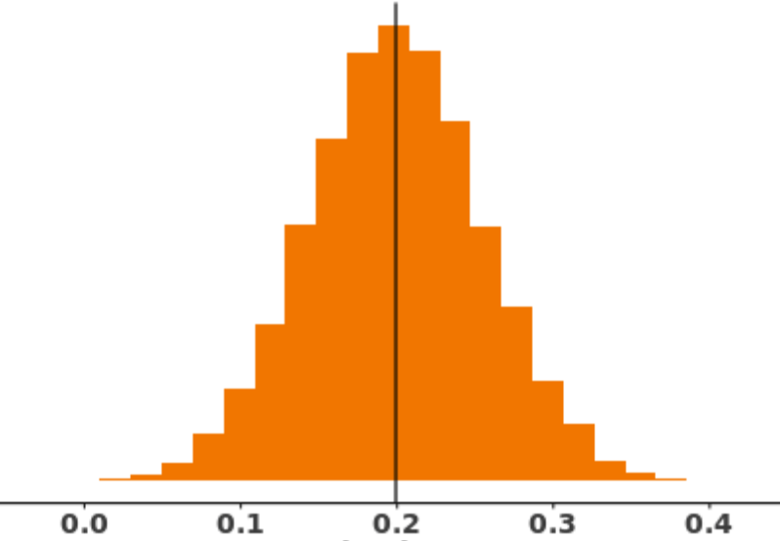
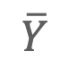
Confidence Intervals
a b c d
What do we know about distances a, b, c, and d?
●
●
●
$$\overline{Y}$$
.585
?
?
Because these distributions are identical except in their means, the distances must be equal.

Slide 31
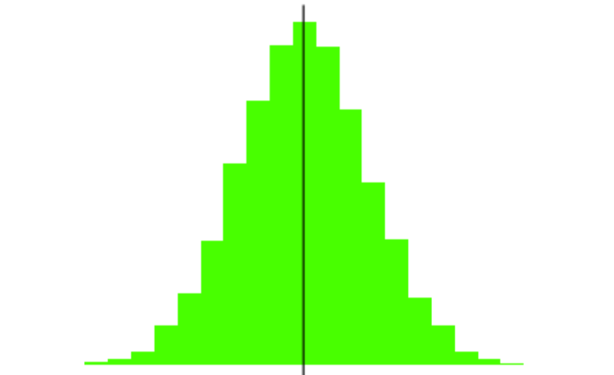
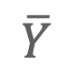
Confidence Intervals
a b c d
What do we know about distances a, b, c, and d?
●
●
●
$$\overline{Y}$$
.585
?
?
We can construct a new copy of the sampling distribution, centered at our sample mean…

Slide 32
Confidence Intervals
a b c d
What do we know about distances a, b, c, and d?
●
●
●
$$\overline{Y}$$
?
.585
?
… and use this sampling distribution to directly calculate the lower and upper bounds.

Slide 33
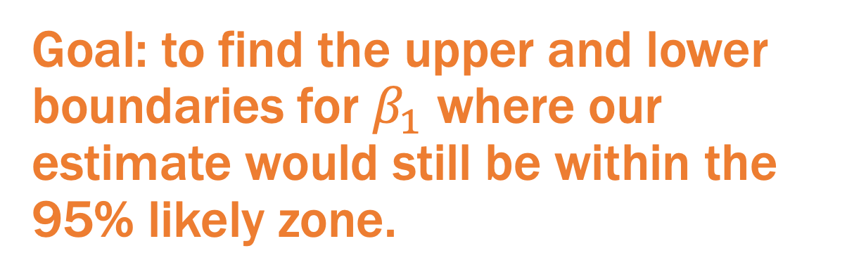
Goal: to find the upper and lower boundaries for $β_{1}$ where our estimate would still be within the 95% likely zone.

Slide 34
Using the randomized sampling distribution
Discuss: how can we calculate the confidence interval from this distribution?

Slide 35
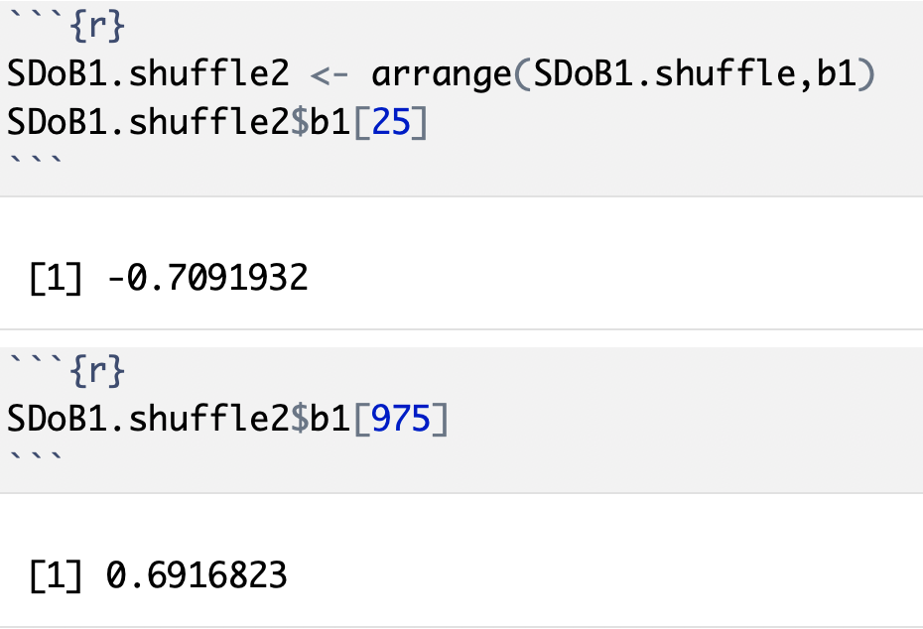
Finding the 95% cut points
How do we get from this to a confidence interval?

Slide 36
Using the normal curve to model sampling distribution of b1: confint()
Simulated Randomized

Slide 37
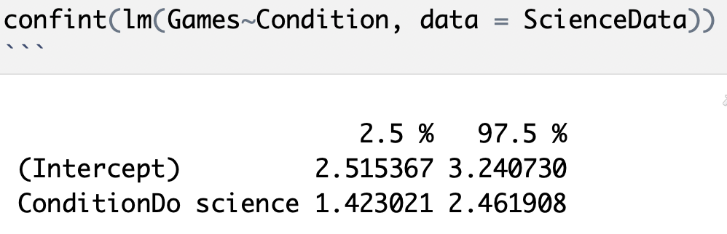

Slide 38
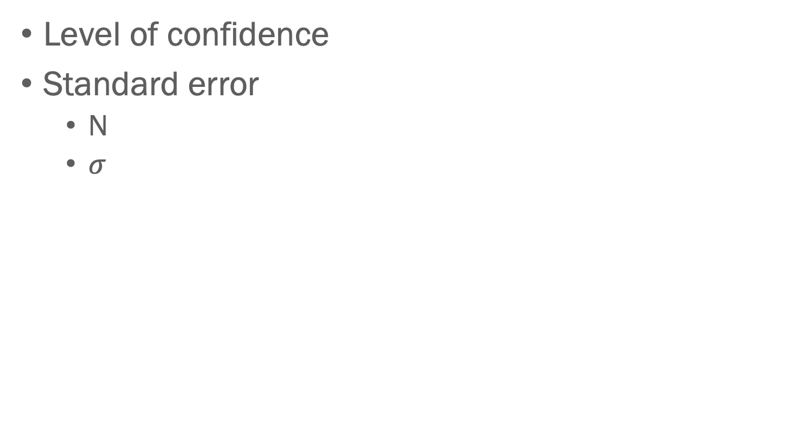
What Affects the Confidence Interval?
Level of confidence
Standard error
N
$σ$

